Slide 1
Project Overview and Recommendations
Big Mountain Ski Resort
Presented by
Miranda Haynes
2025

Slide 2
Content
1
Problem Identification
2
Key FIndings
3
Modeling Results
4
Analysis and Recommendations
5
Summary
2025

Slide 3

Big Mountain Ski Resort aims to identify and optimize key features to maximize seasonal revenue.
Problem Identification
2025

Slide 4

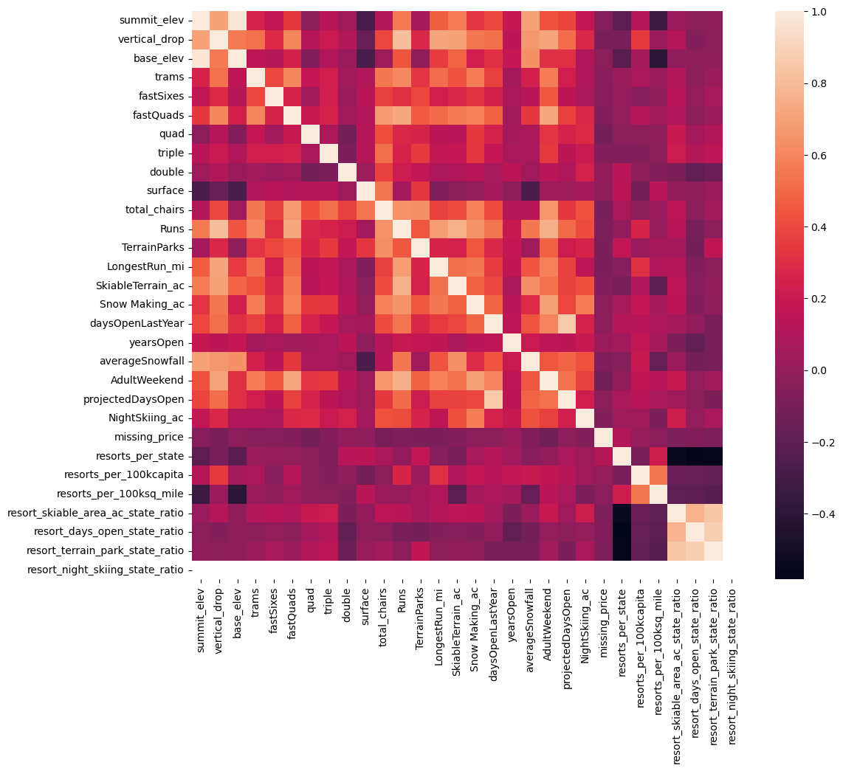
Key Findings
Features
Highly profitable resort features
Vertical Drop
Total chair lifts
Snow making
Number of runs
Length of longest run
Accessibility to nearby parks
Features that do not impact pricing
Night skiing
Total days open
Trams
Heat map of feature relationships
2025

Slide 5
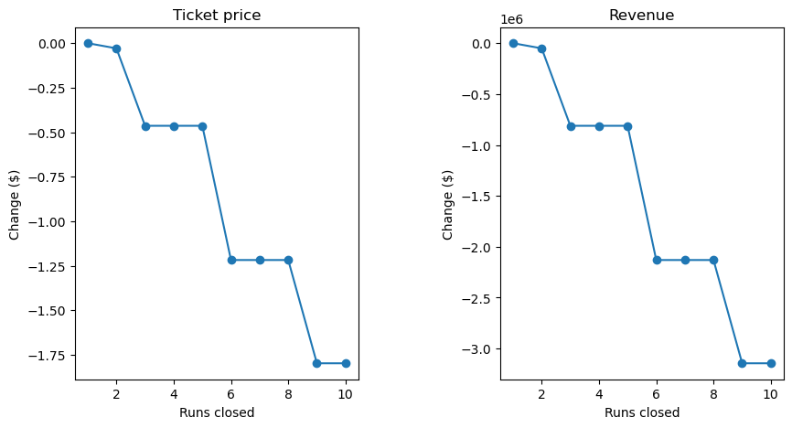
Modeling
Model objective: Determining how to adjust key features to maximize adult ticket prices.
Type: Random Forest
Accuracy
Linear model has higher variability
Random forest has a lower mean absolute error
Key features determined by model
Fast quads
Snow making
Runs
Vertical Drop height
The graph shows how ticket price and seasonal revenue would be affected with each run being closed.
2025

Slide 6
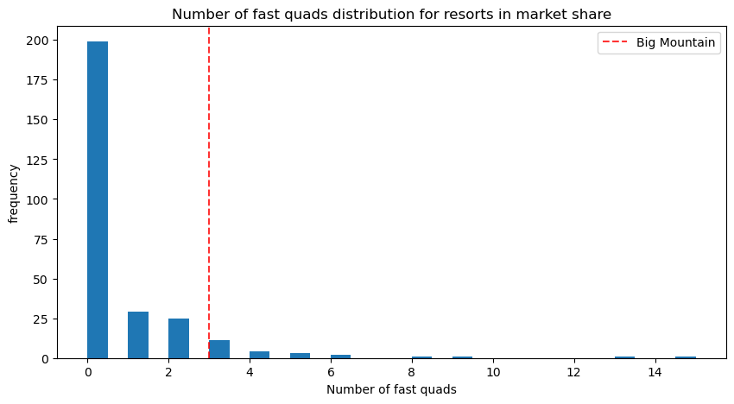
Fast Quads’ competitive
advantage
We have more fast quads than the regional average
3 fast quads sets us apart from competitors
The U.S. average is 0
Adding more fast quads will not greatly impact ticket pricing
Operational costs would be greater than the additional revenue
2025

Slide 7
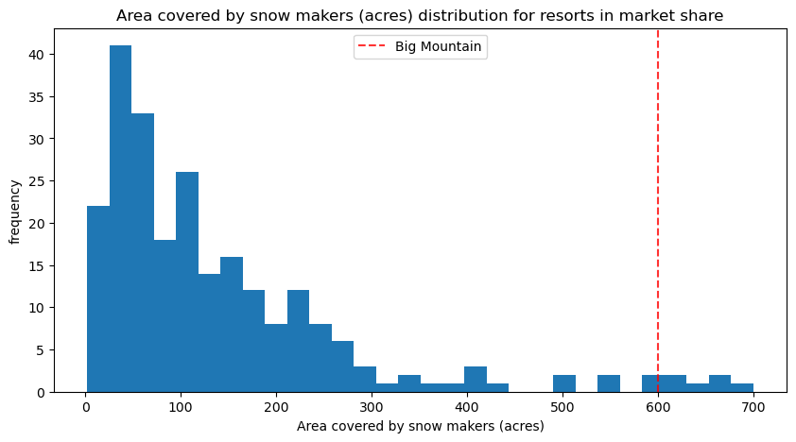
Snowmaking capabilities
Above average coverage
Big Mountain exceeds the average snow making in the U.S.
Model Insight
A 2 acre increase shows no measurable impact on revenue
Cost vs. Benefit
Operational costs would outweigh any gain in revenue, if any
Additional acreage, unless substantial, would offer no strategic advantage
Current snow making capabilities are sufficient to support competitive pricing and guest satisfaction
2025

Slide 8
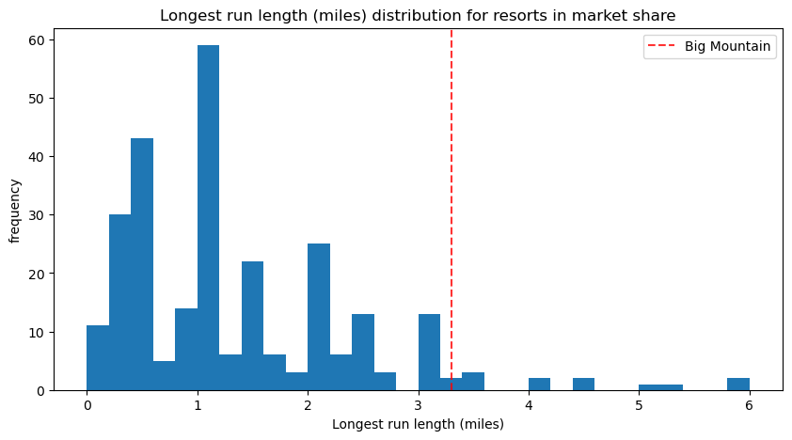
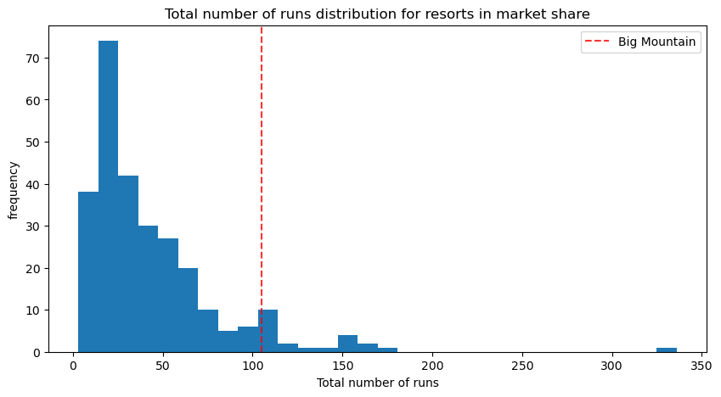
Optimizing Runs
Highly competitive feature
We are above average in both total number of runs and longest run length
Closing 1-4 runs will not impact ticket prices
More than 6 leads to a steep decrease in ticket price and seasonal revenue
Model Insight
Increasing the longest run by 0.2 miles does not significantly impact ticket pricing
It would be better to remove less than 5 low traffic runs to save on maintenance without sacrificing guest experience
2025

Slide 9
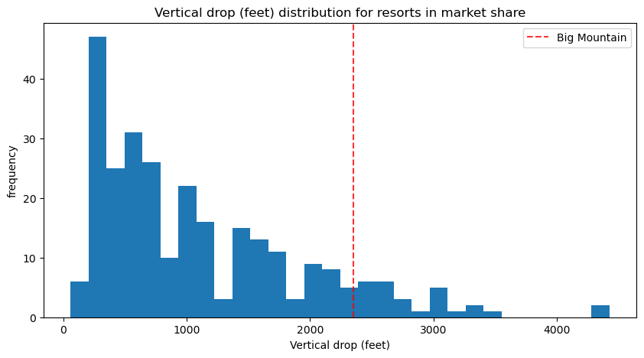
Vertical Drop Height
Standing
Big Mountain is above average in this feature, but there is room for growth
Model Insight
Increasing vertical drop height by 150 feet will increase ticket prices by $1.68
$3 million in additional revenue seasonally
Larger height increase
Increasing vertical drop height by 300 feet would more than double the listed seasonal revenue increase
Strongly suggests a large investment in this feature
Considerations
Maintenance costs
Safety risks
Environmental impact
2025

Slide 10
Analysis and Recommendation
Our model evaluated 4 key features; fast quads, vertical drop height, snow making area, and runs, to determine impact on seasonal revenue and ticket prices. Removing a few underused runs and increasing vertical drop heights would increase revenue the most. Expanding vertical drop height increases ticket pricing, while selectively removing the runs will decrease operational and maintenance costs.
2025

Slide 11
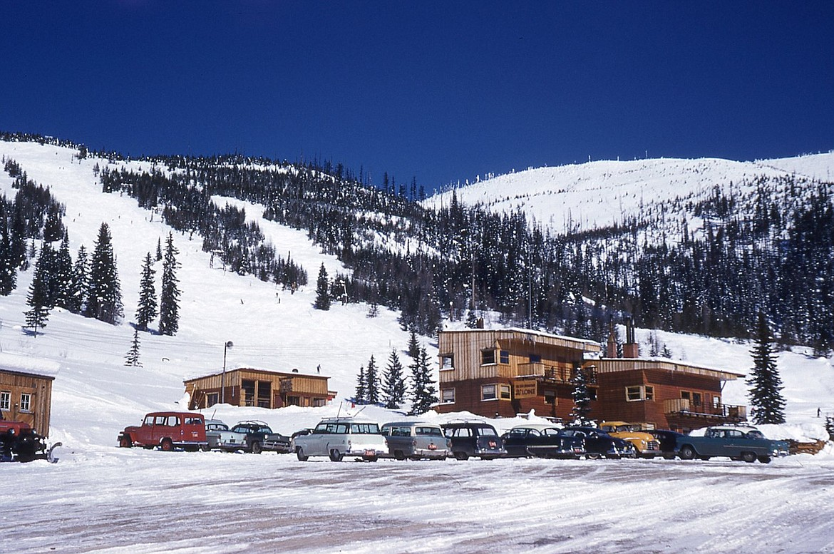
Summary
Big Mountain is a well positioned resort with many ‘above average’ features
Modeling shows the most effective improvements are increasing vertical drop height and closing underused runs
All features listed are highly profitable but snowmaking and fast quads are already optimized
Following suggested adjustments offers the most returns without sacrificing guest experience and requiring significant financial investment
2025

Slide 12
Thank you
2025

